Slide 1
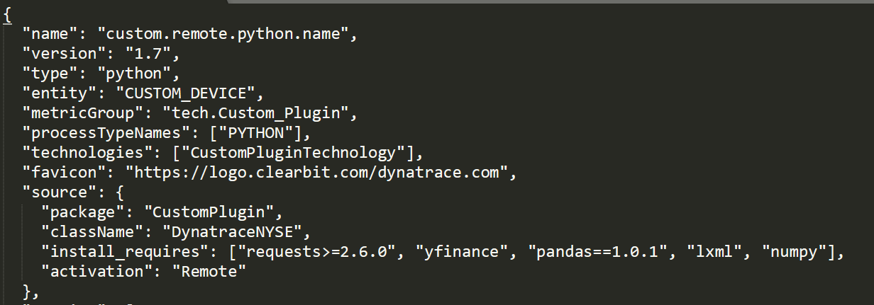
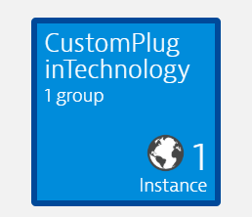
Analyzing the JSON
“name” is simply the name of your plugin
“version” is the version of your plugin, this must change if you are updating the plugin, the server will reject the updated version if this is not changed
“entity” is what you are creating
“metricGroup” is what you will use to chart data in for dashboards etc
“processTypeNames” you can set this to what you like, it will appear in the Technologies section as follows

Slide 2
Analyzing the JSON
“Favicon” can be used to set the logo to be displayed
“source” relates to the python file which is being ran
“package” must be the name of your python file
“className” must be the name of the class name in the python file
“install_requires” these are the libraries which the plugins python will need to download, remember that the python which exectutes the plugin is not the same python which is installed on the ActiveGate server. This is why you must specify here anything that you installed when testing/creating the plugin

Slide 3
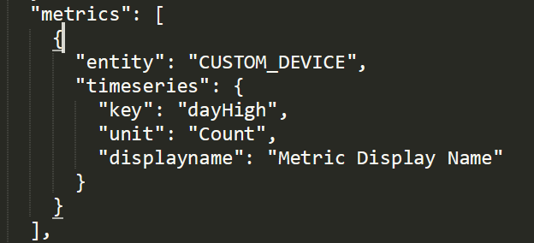

Metrics
“entity” is what you are creating/updating
“timeseries” is defining the metrics you are passing in
“key” this must match the Key which is specified in the Python file
“Unit” is the unit of the metric, the list of the available placeholders can be found in the Custom Metrics API documentation
“displayName” will be what you want the metric to be displayed as. This will be seen like this

Slide 4
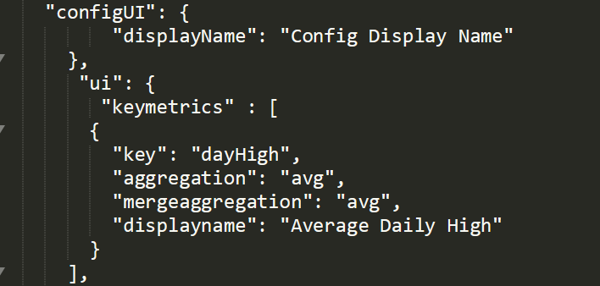
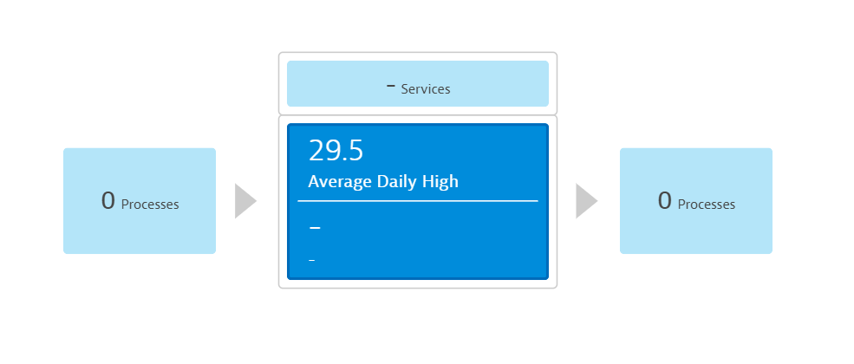
ConfigUI
This section allows us to configure the plugin
“displayName” will be shown on the settings page in the Dynatrace UI
The key metrics part will list what metrics you want to be displayed as key metrics, this will look like the following

Slide 5
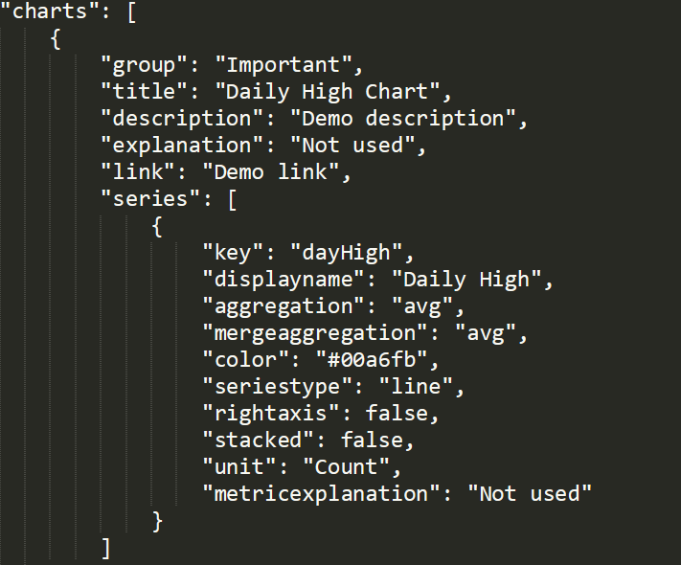
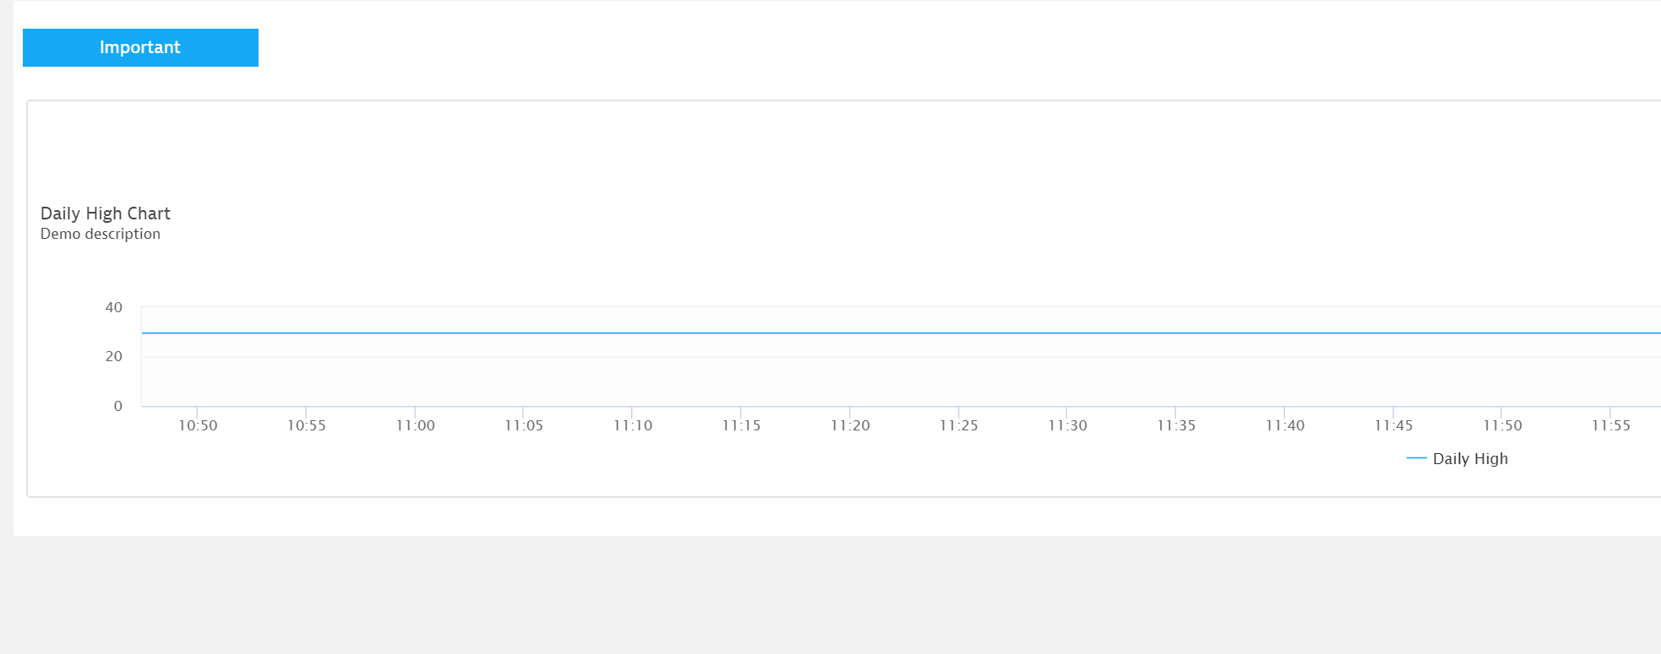
Charts
Charts will allow you to further personalise where and how the metrics are displayed.
You can see where these metrics are by looking around the UI, and from the screenshot below.

